Slide 1


Putting Laravel into place

Slide 2



Eva Islam
ID: 2020-1-60-273
Sajib Khan
ID: 2020-1-60-186
Nur Adnan Chowdhury
ID:2020-3-60-007

Slide 3
MVC is a popular design pattern for developing web applications.
5
Over
View of MVC
The Model is responsible for interacting with the database and storing data.
4
3
2
1

Slide 4
MVC is a popular design pattern for developing web applications.
5
4
A software engineering design pattern called MVC is used to divide an application into three interrelated components, each with a certain set of duties. Model, View & Controller
3
2
1

Slide 5
MVC is a popular design pattern for developing web applications.
5
4
Developers can concentrate on particular features of the software without tightly connecting them by breaking the application up into separate components. The codebase is now simpler to comprehend, alter, and maintain as a result.
3
2

Slide 6
MVC is a popular design pattern for developing web applications.
5
It is simpler to reuse Models, Views, and Controllers in different areas of the application or in other projects because each component has well defined roles.
4
3

Slide 7
MVC is a popular design pattern for developing web applications.
5
A well-liked design pattern for creating web apps is MVC.It may be used with any language, including JavaScript, PHP, C, and C sharp.
4

Slide 8
MVC is a popular design pattern for developing web applications.
5
As long as the interfaces are clearly specified, MVC encourages developer collaboration because various team members can work on separate components without interfering with each other's progress.

Slide 9

MODEL:
The Model is responsible for interacting with the database and storing data.

Slide 10

VIEW:
The View is responsible for displaying the data to the user.

Slide 11

Controller :
The Controller component would receive user input and direct the flow of the application.

Slide 12



Response Information
Send Data
Request Information
Request
Response

Slide 13
LARAVEL

Slide 14



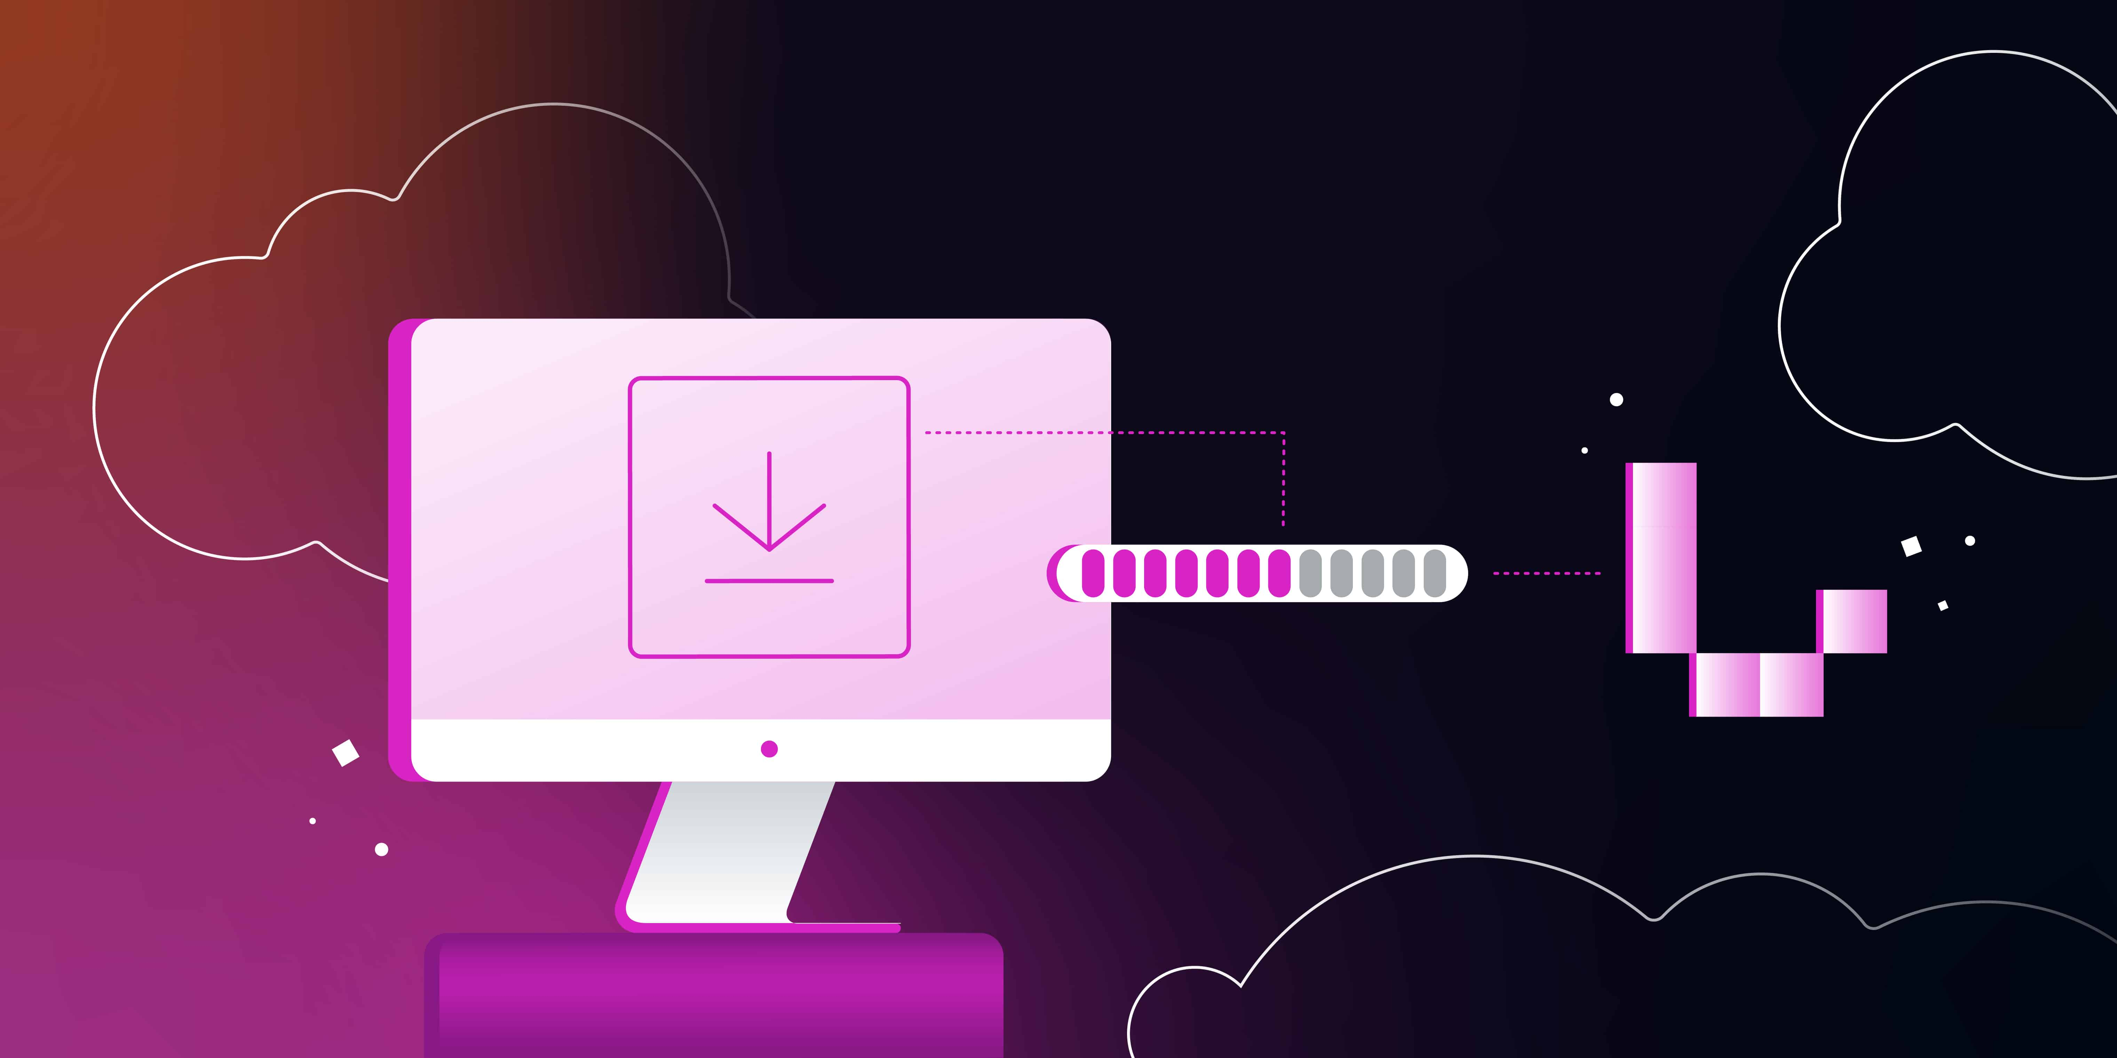




Installation of Laravel

Slide 15
Install Composer
Composer is a dependency manager for PHP. It is used to install Laravel and its dependencies. We can download Composer from the Composer website: https://getcomposer.org/download/.
Installation of Laravel

Slide 16
Verify Composer installation
Once Composer is installed, you can verify the installation by running the following command in your terminal:
Composer
If Composer is installed correctly, you should see the following output:
Composer version 2.2.6 2022-07-08 13:47:40
Installation of Laravel

Slide 17
Install Laravel
We can install Laravel using the following command:
composer create-project laravel/laravel my-app
This will create a new Laravel application called my-app in the current directory.
Installation of Laravel

Slide 18
Verify Laravel installation
Once Laravel is installed, we can verify the installation by running the following command:
cd my-app php artisan serve
This will start the Laravel development server on port 8000. You can access your Laravel application in your web browser by opening the following URL:
http://localhost:8000
Installation of Laravel

Slide 19
Set your application key
The application key is a secret string that is used to encrypt user sessions and other sensitive data. We can set the application key by running the following command:
php artisan key:generate
Installation of Laravel

Slide 20
Configure your database.
Laravel uses a database to store data. You need to configure the database connection in the .env file.
Installation of Laravel

Slide 21
Create a new controller & view
Controllers are responsible for handling HTTP requests. We can create a new controller by running the following command:
php artisan make:controller WelcomeController
Views are used to render HTML pages. You can create a new view by running the following command:
php artisan make:view welcome
Installation of Laravel

Slide 22

Laravel's popularity has also been aided by the MVC pattern's smooth integration. Eloquent, the framework's ORM, and the Blade templating engine all collaborate to support clean code architecture and effective development techniques. With Laravel's implementation of the Model-View-Controller paradigm, developers can easily build adaptive and extensible apps that can be expanded or scaled as project requirements change.

